Slide 1
Update Road Management Office Ireland April 5th 2016

Slide 2
Road Management in Ireland - Network
Apx. 100,000km of public roads
5500km of National road (interurban motorway - legacy rural road <2500 AADT)
95000km Non-national road
13500km Regional road strategic and inter (40000 – 1000AADT)
81000km of local roads - <100 AADT – 10000AADT)

Slide 3
Road Grant Profile 1994 - 2015
Year | National Grants | RLR Grants
1994 | €246 m | €139 m
1997 | €331 m | €226 m
2000 | €657 m | €341 m
2003 | €1,223 m | €437 m
2005 | €1,317 m | €501 m
2007 | €1,768 m | €608 m
2009 | €1,488 m | €451 m
2011 | €723 m | €453 m
2013 | €321 m | €401 m
2014 | €364 m | €359 m
2015 | €364 m | €294 m

Slide 4
Non National Grants in 2015
Restoration Improvement €146m
Restoration Maintenance €41m
Discretionary Grant €63m
Bridge Rehabilitation €8m
Specific & Strategic €16m
Urban Block €4m
Low Cost Safety €8m
Miscellaneous €8m

Slide 5
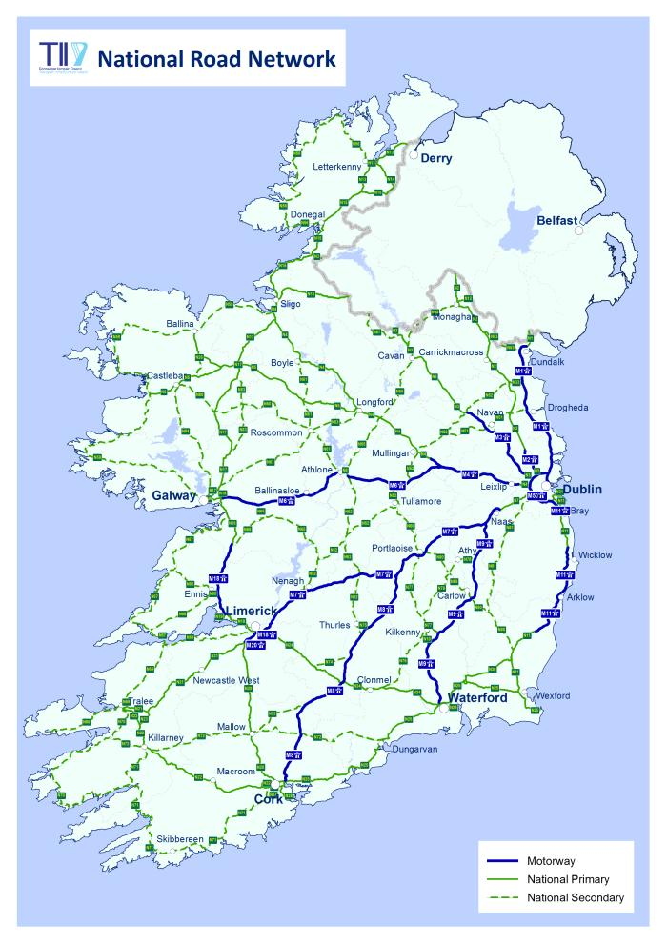
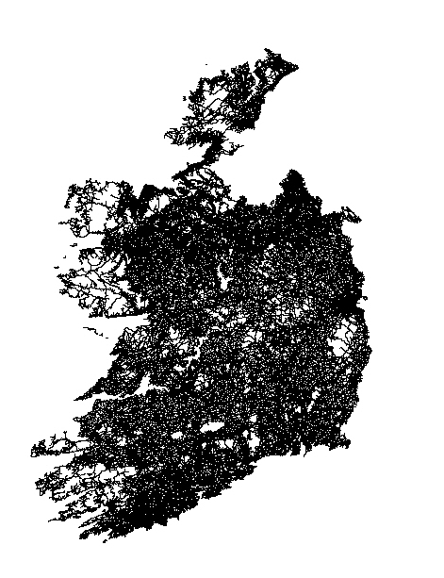

Slide 6
Road Management in Ireland Stakeholders
Funding and policy direction for national roads
Department of Transport, Tourism and Sport
Transport Infrastructure Ireland (formerly National Road Authority and Railway Procurement Agency)
Funding and policy direction for non national roads
Funding and policy direction for national roads
Funding and decision making within national policy
31 Local Authorities ( Formerly 114 Local Authorities) who are Roads Authorities (functions include maintenance and construction as well as liability)

Slide 7
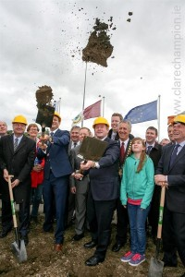
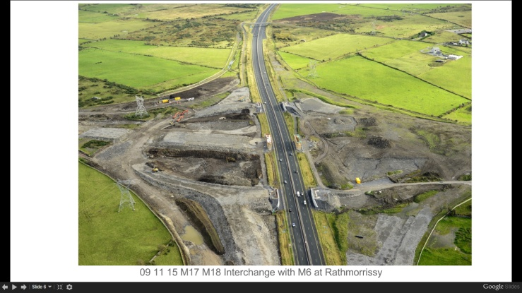
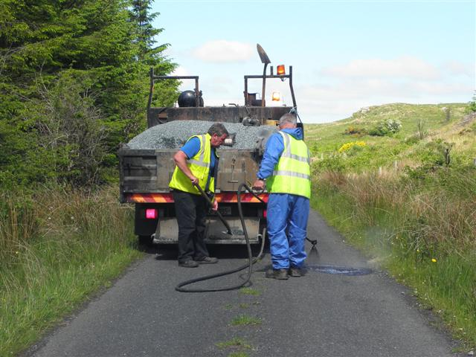
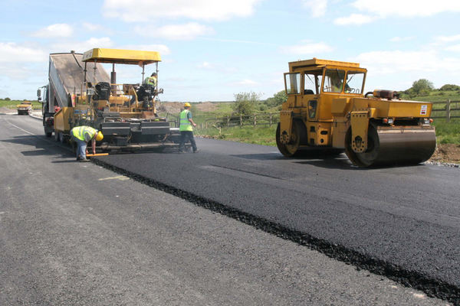
Pavement Management: Overview
Roads require a balance of:
Maintenance (or Preservation)
Improvement (or Development)
Pavement Management:
To optimise the overall performance of the network over time in accordance with policy objectives and within budgetary constraints
Typical objectives:
Minimise transport costs
Preserve asset value
Provide and maintain accessibility
Provide safe and environmentally friendly transport

Slide 8
Challenges – Non National Network:
The maintenance cycle high 4%, on average, leading to a maintenance cycle time of over 80 years for some local roads).
Abnormal weather events increasing with associated affects on network
Significant duplication of back office resources devoted to policy development, technical support and administration)
Over-reliance on the knowledge of key individual staff particularly frontline staff now departing. (Numbers 35000 staff Q4 2008 26000 staff Q1 2015)
Various approaches to asset management.
Limited consistent, evidence-based maintenance planning to ensure reliable performance and to avoid critical system deficits.
Work planning and tracking to record work done, cost incurred and performance of assets.
And others!

Slide 9
Our Mission statement:
To Provide to Local Authorities in Ireland centralised supports, forums, guidelines and technology to support and foster:
improved roads asset management outcomes
best practice and capacity in Local Authorities
efficient management of road licensing activities
administration of funding
technical input to national policy development on road and transport issues
consistency in road maintenance and investment

Slide 10
Current Areas of Work
Pavement Condition rating
Works Recording
Inventory
Footway Condition Rating
Drainage Condition Rating
Road Licensing

Slide 11
Pavement Management: Recording works done.
Before 2014
Six-10 counties using MapRoad
Work during 2015
Working with DTTAS and Local Authorities to support do returns for grants on MapRoad
Outcome 2015
28 counties using the system to record all works planned and completed
Limited work completed or planned recorded on system
Upgrades to system to support tracking and out turn records
Three year programme being returned through the system

Slide 12
Pavement Management: Recording works done.
Restoration Maintenance:
1600 projects
25 LAs
€38M (15% - 48% on regional)
1900km
Restoration Improvement:
1750 projects
€121M (12%-48% on regional)
1500km
2016-2019 Three Year Programme:
Work ongoing
C. 5000 projects planned
C. €400M recorded works

Slide 13
Pavement Management: Inventory.
Before 2014
No precise knowledge of what surfaces of road are.
Developed mobile app system with LGMA and DTTAS and worked with LAs to implement
Outcome 2015
Mobile app in place to record road surface types
Work during 2015
Surface type being recorded in 28 LAs
Limited details as to what works were carried out in the past except paper record in DTTAS
Developed Circular with steering group and worked with LAs to implement

Slide 14
Pavement Management: Condition rating
Before (2014)
Six-10 counties using MapRoad
Work during 2015
Implementation of DTTAS circular RW 21
Outcome 2015
28 counties using the system to survey network
Surveying being carried out on adhoc basis
Working with LGMA and LAs to support surveying using system and uploading historic data
Training needs identified and supports to be put in place during 2016
No standard specifications for mechanical surveys
No historic record of mechanical survey
Development and tendering of mechanical survey framework
Mechanical survey framework in place
Tender available for 2016 regional road survey

Slide 15
Mechanical Surveys:
First records of before and after intervention and outcomes.
PSCI
65000km recorded
First national record of overall condition of network
Western Region Mechanical Surveys 2015 RW 21
Local Authority | Before | After | Network
114
115
116 | ü | ü | ü
117 | ü | ü | ü
118 | ü | ü | ü
Northern Region Mechanical Surveys 2015 RW 21
Local Authority | Before | After | Network
101 | ü | ü | ü
102 | ü | ü | X
103 | ü | X | X
104 | ü | ü | ü
105 | ü | X | X

Slide 16
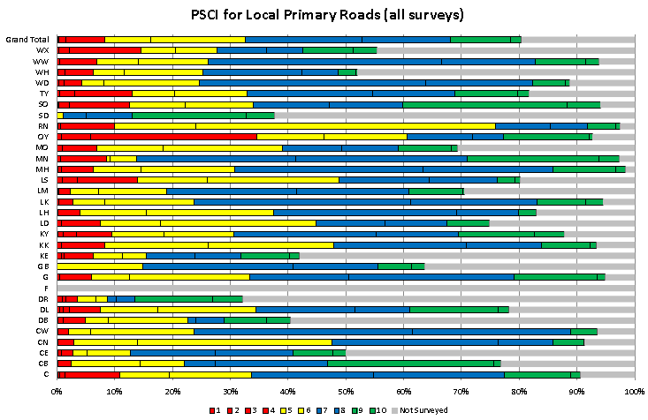
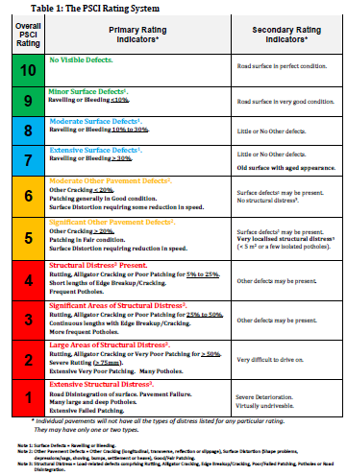
Pavement Management: Condition rating

Slide 17
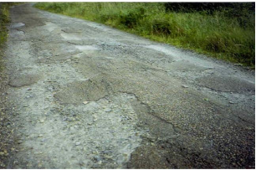
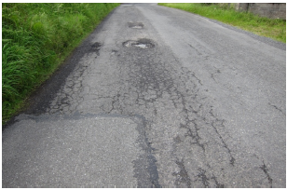
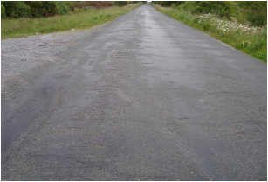
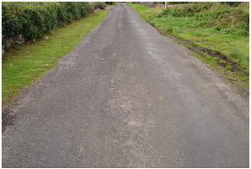
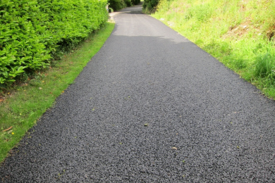
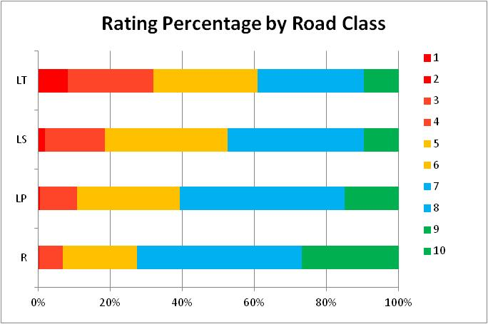

Slide 18
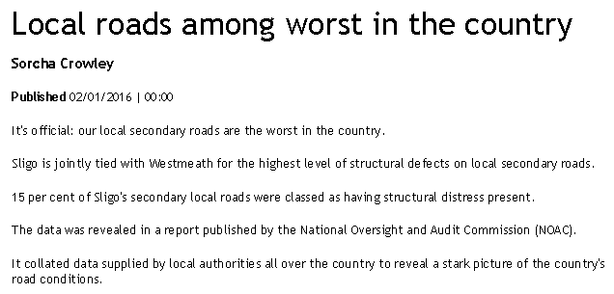
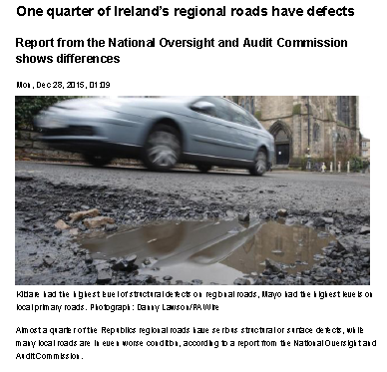
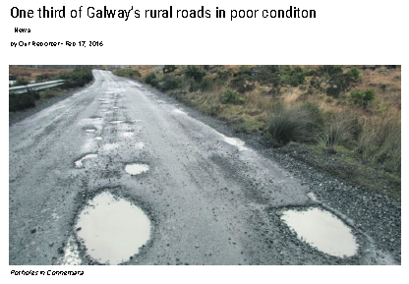
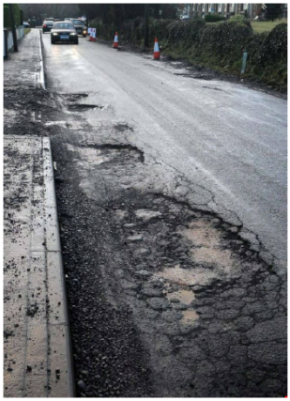
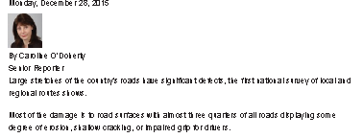

Slide 19
Pavement Management: Benefits
Efficiency
Reporting to DTTAS. Reporting to NOAC
Costs
Outputs
Mobile app. Cloud based
Reduced paperwork
Available to all
Tracking of projects
Live record of Works planned and completed
Links to road licensing and utility investment
Effectiveness
Permanent mapped record works completed and planned.
Recording of material types.
Recording of interventions. Tracking into future
Recording of condition
Back analysis of effectiveness of treatment
Cost and investment planning

Slide 20
Our Services:
The work of the RMO is developmental in nature and subject to review of by the RMO board and stakeholders. Notwithstanding this our current scope of service is summarised below:
Policy Development | Development of policies for pavement management to comply with best international practice: | Pavement Management Planning Condition Rating Network Key Performance Indicators
 | Development of Road Licensing policy to support government, utility and Local Authority Objectives. | Road Opening Licensing Abnormal load Licensing Other road furniture and closure licensing
 | Development of policies to support local authorities in their asset and inventory management including: | Bridges Public Lighting Footways Regulatory Signage Safety Assets

Slide 21
Our Services:
Software and Technology Development: | Mobile apps: | Survey App Pavement Condition Footway condition Bridge Inspections Inventory Record Drainage Condition
 | Works App | Road Licensing Notifications App Inspection App Cloud supports
 | MapRoad | Finance Management Grant Administration
 | Reporting | Road Licensing Road Condition Roadworks
Guidelines Development to support activities including: | Pavement Maintenance and Improvement: | Condition rating Drainage maintenance Footway management and maintenance
 | Roadworks Licensing: | Management of Roadworks Reinstatement standards
 | Bridge maintenance and improvement

Slide 22
Our Services:
Centralised supports for: | Procurement: | Mechanical Surveys Consultancy Services Testing Services
 | Software | Data Storage and Management Payments
 | Road Licensing | Deposit management Insurances for Licence Holders
 | Reporting | NOAC Departmental Local Authority

Slide 23
Objectives, Deliverables and priority themes for 2016:
For 2016/2017 the RMO deliverables can be summarised under the following broad headings:
Develop and improve customer service to stakeholders
Provide Improved Asset Management Tools and supports to Local Authorities
Develop supports for other Road Licensing Activities by LAs
Improve working with other agencies including TII, RSA, Utilities, IPB
Delivery of Business Process Development and supporting Software
Sustainability and Governance

Slide 24
www.rmo.ie
stephen.flynn@rmo.ie

